Slide 1
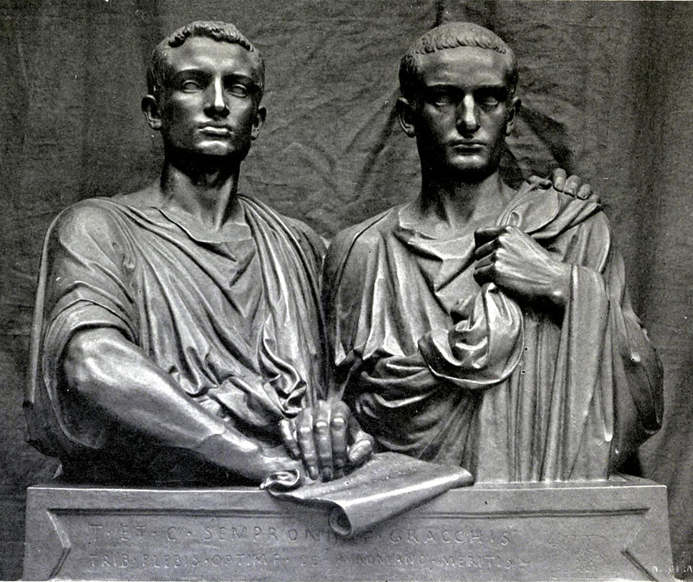
Tiberius Gracchus
GOAL/S: Describe the life of Tiberius Gracchus
Explain the Lex Agraria
Week 4, Lesson 2

Slide 2
DISCUSSION: What picture does this paint of Tiberius Gracchus?
According to Roman historian Velleius Paterculus, Tiberius Gracchus was:
a man otherwise of complete integrity of life, of brilliant intellect, of great consistency of purpose, in short, equipped with all the qualities as the human condition allows when brought to perfection both by nature and effort
Velleius Paterculus, c. 30 BCe, Roman History, Book 2, 2.2

Slide 3
What problems was Rome facing around 133 BCE?
discussion
Notes:
Internal struggles – not adapting to new expansion
Increase in slaves and war demands economic struggles
Land Crisis
Senatorial Factions – Optimates and Populares blocking reforms

Slide 4
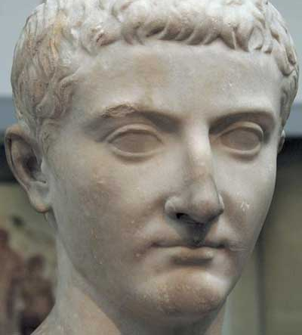
Tiberius Sempronius Gracchus
Born: c. 169–164 BCE
Died: 133 BCE
Father: Tiberius Gracchus the elder
one of the most powerful men in Rome during the second century BCE who had held positions of consul, censor and provincial governor.
Many of his opponents considered him a political opportunist.
Mother: Cornelia Africana
daughter of Scipio Africanus – general responsible for defeating Hannibal at the Battle of Zama in 202 BCE.
Upbringing: Cornelia carefully supervised his education – a balance of traditional Roman values and the best of Greek learning. His Greek education meant that he often associated with liberal aristocrats and intellectuals.

Slide 5
Political Career
Served as quaestor and was sent to Spain to fight the Numantines (Spain)
To save the defeated Roman army, Tiberius arranged a treaty with the Numantines.
Roman people were happy with this and regarded him as a hero
The Senate was angry that he operated outside his position. The Senate refused to ratify the treaty
This experience, along with the suffering of the Roman people he had seen while fighting in Numantines, lead him to run as Tribune of the Plebs
QUAESTOR: Financial official who managed taxes, treasury, army pay and all monetary matters
TRIBUNE: Magistracy position representing the plebeian class

Slide 6
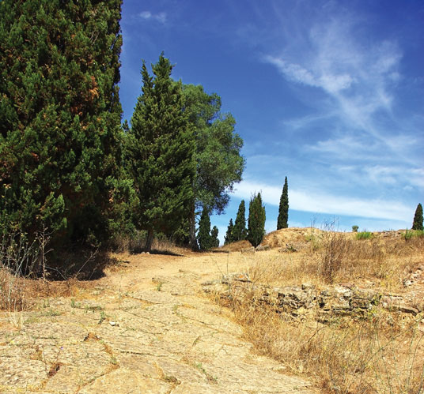
Lex Agraria
DEFINITION:
A Latin term that translates to "agrarian law"
land reform laws that were aimed at addressing issues related to land distribution, especially in the context of public land (ager publicus).
The most FAMOUS Lex Agraria was passed in 133 BCE by Tiberius Gracchus!

Slide 7
Tiberius Gracchus (15 min)
https://www.youtube.com/watch?v=d32HTuUCS-w&ab_channel=MemoriaPress

Slide 8
Draw the following in your book (full page)
What is it? | Aims | Intentions | Aftermath

Slide 9
What is it?
Summarise in your table
Using his position as Tribune, Tiberius wanted to pass reforms that would alleviate the suffering of the poor. The bill proposed that:
Small farms would be created out of land acquired after the Second Punic War and given to those who
had lost land previously or were unemployed.
New owners were to pay a small rent, and were forbidden to sell their holdings.
Present landowners could not keep more than 130 hectares.

Slide 10
Aims
Summarise in your table
Redistribute land to the poor and enable those with no source of income or employment to establish farms
Increased the number of landowners to make it possible for these people to become involved in politics –
Reducing the monopoly that the wealthy had on political power and authority
Provided more troops for the Roman army.
Its provisions further aimed to stop aristocrats, who would have land taken from them, from seeking revenge.

Slide 11
Tiberius’s true intentions behind the Lex Agraria are widely debated. While they certainly speak of a desire to help the poor and recognition of their need, he was also ‘obliged’ to achieve something given the reputation of his father but the law would have also made him popular and thus securing support in future elections. However, Tiberius made what would become fatal errors in the methods he employed to achieve his aims. Rather than following convention, Tiberius became increasingly revolutionary in his dealings with the Senate.

Slide 12
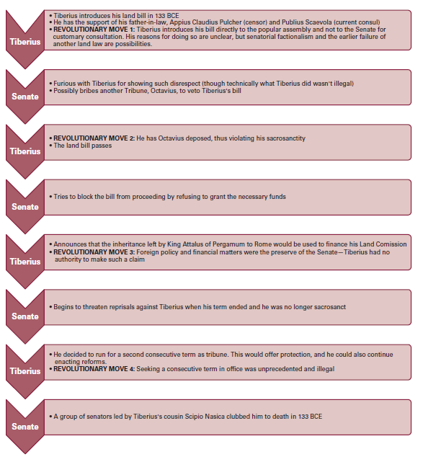
Intentions
Summarise in your table

Slide 13
Aftermath
Summarise in your table
Following the death of Tiberius, Lex Agraria continued to function
The Senate was not opposed so much to the bill, but rather the methods Tiberius used to achieve its passing
There was an increase of 76,000 property owners between 131 BCE and 125 BCE
Tiberius’s actions were significant because it demonstrated what was possible when one individual with power and authority forced their way to achieve change
Tiberius demonstrated how being popular among the plebeians was key to real power and that the Senate was not all-powerful and invincible

Slide 14
ACTIVITY – Create an Essay Plan
Choose ONE (1) of the following questions and create an Essay plan
Describe the Senate’s response to Tiberius Gracchus’ attempt to stand for the tribunate a second time
Assess the impact that Tiberius Gracchus had on plebeian life.
Evaluate Tiberius Gracchus’ motives as a leader calling for change.
WRITE YOUR ESSAY QUESTION AT THE TOP OF YOUR PAGE

Slide 15
Essay Question:
Introduction: | Thesis Statement Background Information Essay Map
Bp 1 | Topic Sentence Explanation/Evidence Explanation/Evidence Link
Bp 2 | Topic Sentence Explanation/Evidence Explanation/Evidence Link
Bp 3 | Topic Sentence Explanation/Evidence Explanation/Evidence Link
Conclusion

